Slide 1

Analyzing Temporal Data with Time Travel and Versioning Capabilities
Database Management System | SQL and Advanced Query Formulation
Course: Database Management System | Chapter: SQL and Advanced Query Formulation | Program: B.TECH-CSE, B.TECH CSE - CYBER SECURITY, B.TECH CSE - DATA
DISCOVER · LEARN · EMPOWER
Notes:
Welcome students to this advanced session on temporal data. We will explore how modern SQL handles time, moving beyond simple snapshots to full versioning. This capability is crucial for auditing and historical analysis in real-world systems.

Slide 2
Course Outcomes
SLIDE 2 / 14
Course Outcome
CO | BT LEVEL | DESCRIPTION
CO1 | BT2 | Explain database architecture, relational model concepts and formal query language foundations including relational algebra and relational calculus.
CO2 | BT3 | Apply relational algebra, relational calculus and SQL constructs to formulate correct and efficient database queries.
CO3 | BT4 | Analyze functional dependencies and design normalized relational schemas up to 5NF ensuring lossless join and dependency preservation.
CO4 | BT4 | Analyze transaction schedules and concurrency control mechanisms to determine serializability, recoverability and correctness.
CO5 | BT5 | Evaluate storage structures, indexing strategies and query optimization techniques for performance, scalability and reliability.
Chandigarh University
2 / 14
Notes:
This lecture directly supports our course outcomes. CO3 is addressed as we design schemas that store historical versions of data without losing normalization properties. CO4 is critical because time travel queries must maintain transactional consistency and recoverability during concurrent access.

Slide 3
Learning Objectives
SLIDE 3 / 14
Learning Outcomes
1
Define temporal data and distinguish between valid time and transaction time.
2
Analyze the SQL standard syntax for querying historical data states.
3
Evaluate the performance implications of versioning tables in large datasets.
4
Apply time travel features to reconstruct data states at specific timestamps.
5
Identify common pitfalls in versioning logic that lead to data inconsistency.
Chandigarh University
3 / 14
Notes:
By the end of this session, you will be able to define temporal data types clearly. You will learn to write queries that look back in time, a skill essential for forensic analysis. We will also evaluate the trade-offs between storage and query speed.

Slide 4
Lecture
SLIDE 4 / 14
Defining Temporal Data Types
1
Valid time represents when a fact was true in the real world.
2
Transaction time represents when a fact was recorded in the database.
3
Bitemporal data combines both valid time and transaction time dimensions.
4
Temporal tables automatically manage history without manual trigger implementation.
5
Standard SQL defines SYSTEM_VERSIONING for automatic version tracking.
Chandigarh University
4 / 14
Notes:
Think of valid time as the date a student graduated, while transaction time is when the registrar entered that fact. A bitemporal table tracks both, allowing you to ask 'What was the record on Jan 1st, 2023, and what did it say about the graduation date?' This dual dimension is the core of temporal analysis.

Slide 5
Lecture
SLIDE 5 / 14
SQL Syntax for Time Travel
1
The FOR SYSTEM_TIME AS OF clause queries a specific point in time.
2
The FOR SYSTEM_TIME FROM ... TO ... clause queries a time range.
3
The FOR SYSTEM_TIME BETWEEN ... AND ... clause includes boundary timestamps.
4
The FOR SYSTEM_TIME ALL clause retrieves the complete history of rows.
5
These clauses replace complex self-joins required in older database versions.
Chandigarh University
5 / 14
Notes:
Instead of writing complex joins to find past states, you simply append a time clause to your SELECT statement. For example, querying 'AS OF' a timestamp returns the state of the table exactly as it existed at that moment. This simplifies the SQL syntax significantly for developers.

Slide 6
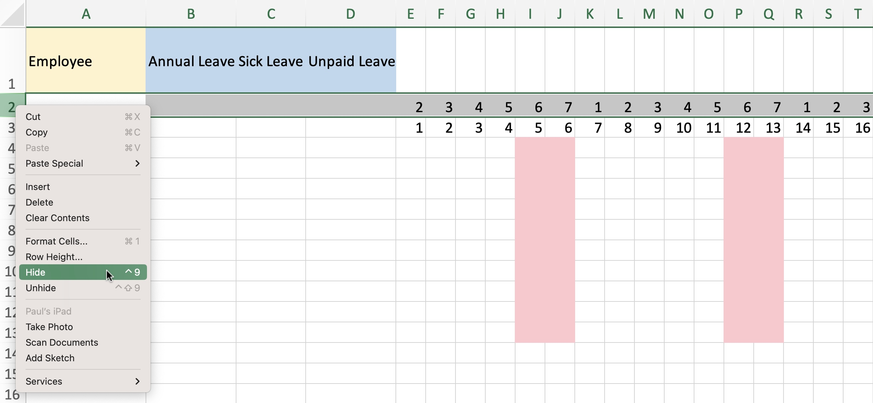
Worked Example
SLIDE 6 / 14
Point-in-Time Query
QUERY
SELECT × FROM Employee FOR SYSTEM_TIME AS OF '2023-06-15'.
SCENARIO
Employee salary was 5000 on June 1st and changed to 6000 on June 10th.
RESULT
The query returns the row with salary 5000 for the June 15th snapshot.
LOGIC
The system filters rows where the valid time interval contains the query date.
OUTCOME
You retrieve the historical state without manually filtering start/end dates.
Source: www.myexcelonline.com
Chandigarh University
6 / 14
Notes:
Let's look at a concrete example. If an employee's salary changed on June 10th, a query on June 15th asking for the state 'AS OF' June 15th will show the new salary. However, if we ask for the state 'AS OF' June 1st, the system returns the old salary of 5000. This demonstrates how the engine handles the temporal logic automatically.

Slide 7
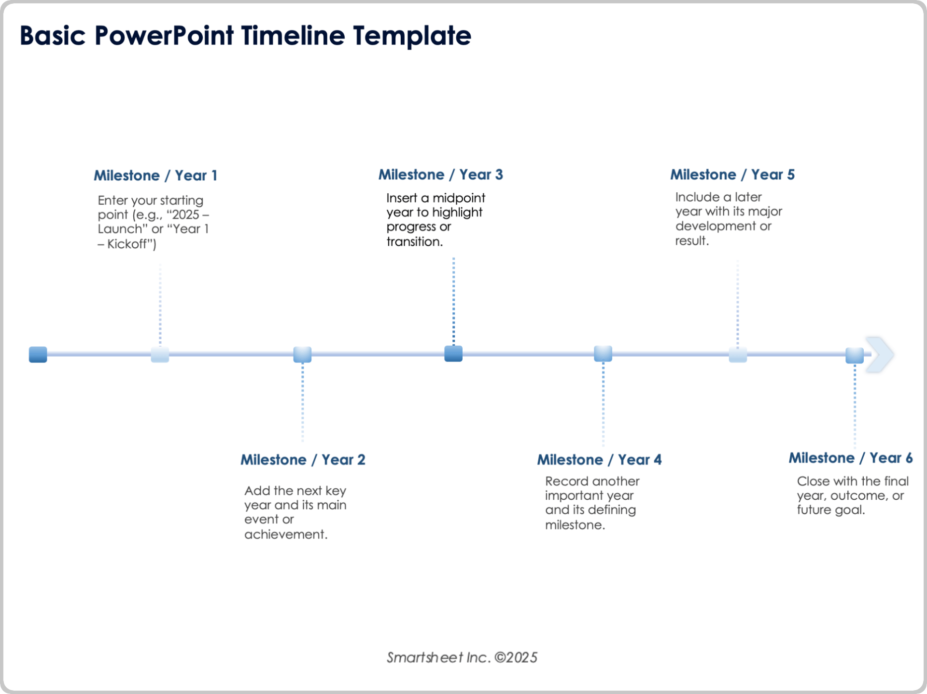
Worked Example
SLIDE 7 / 14
Range Query Logic
QUERY
SELECT × FROM Orders FOR SYSTEM_TIME FROM '2023-01-01' TO '2023-01-31'.
SCENARIO
An order was created on Jan 5th and modified on Jan 20th.
RESULT
The query returns both the original and modified versions of the order.
LOGIC
The system returns all versions where the transaction time overlaps the range.
OUTCOME
You can reconstruct the entire lifecycle of a record within a period.
Source: www.smartsheet.com
Chandigarh University
7 / 14
Notes:
When you query a range, you get every version that existed during that window. If an order was updated on Jan 20th, both the Jan 5th version and the Jan 20th version appear in the result set. This allows you to see the evolution of data over time, which is vital for audit trails.

Slide 8
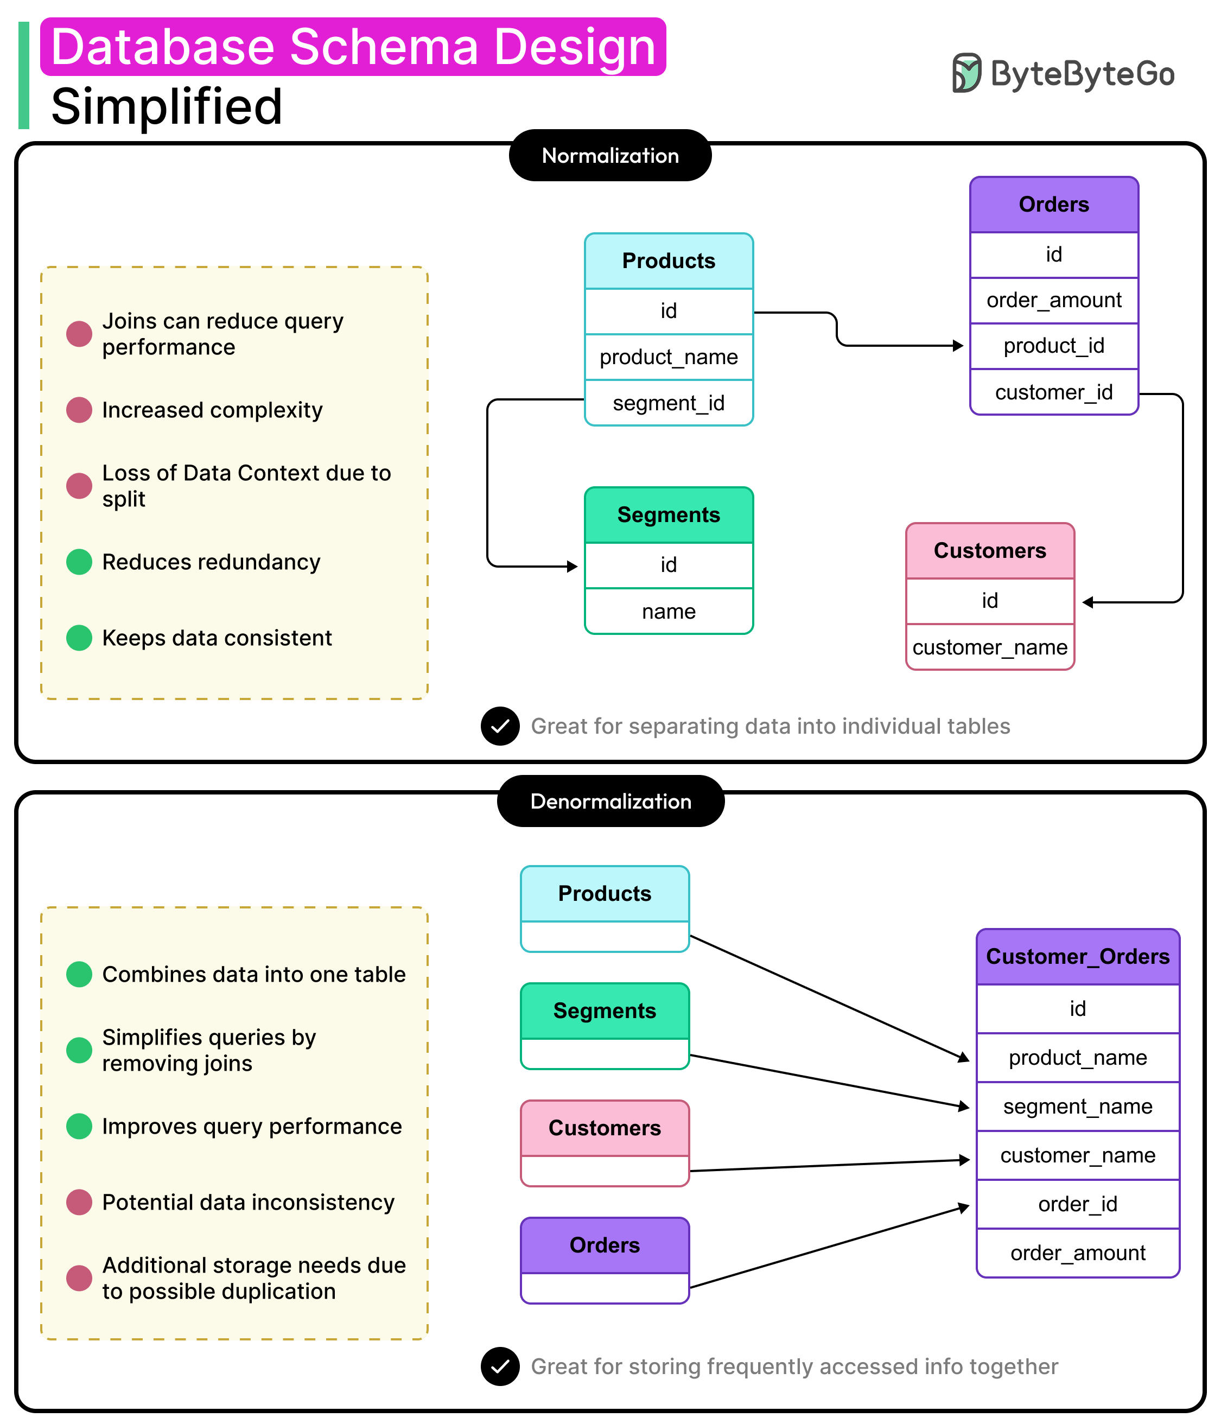
Lecture
SLIDE 8 / 14
Schema Design for Temporal Tables
1
Temporal tables require two hidden system-period columns: Sys_Start and Sys_End.
2
The primary key must be unique and non-nullable to track row identity.
3
System-period columns are managed automatically by the database engine.
4
User-defined columns store the actual business data being tracked over time.
5
Normalization rules (CO3) still apply to the user-defined columns.
Source: substackcdn.com
Chandigarh University
8 / 14
Notes:
Designing a temporal table involves adding two hidden columns that track the system time. These columns are managed by the database, not the user. You must ensure your primary key is robust because it links all historical versions of a single entity together. Normalization principles still apply to your business data columns.

Slide 9
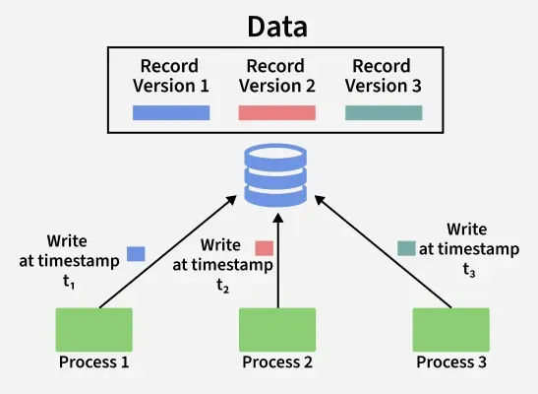
Lecture
SLIDE 9 / 14
Concurrency and Versioning (CO4)
1
Time travel queries must not block concurrent write operations on the table.
2
Multi-Version Concurrency Control (MVCC) maintains multiple versions of rows.
3
Readers do not block writers, and writers do not block readers.
4
Serializability is maintained by isolating the historical view from current changes.
5
Recoverability ensures historical data is preserved even after system failures.
Source: media.geeksforgeeks.org
Chandigarh University
9 / 14
Notes:
This is where CO4 comes into play. Time travel relies on MVCC to allow readers to see old data while writers update the current version. This ensures that a time travel query does not lock the table for other users. The system maintains serializability by isolating the historical view from concurrent modifications.

Slide 10
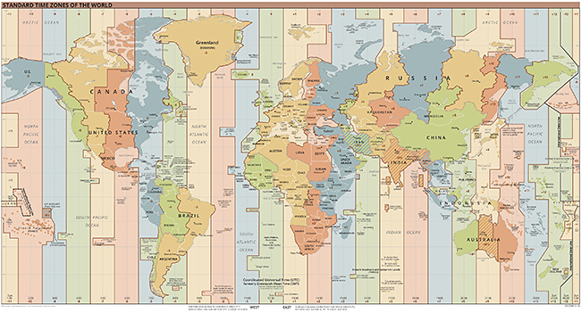
Common Pitfall
SLIDE 10 / 14
Time Zone Errors
1
Inconsistent time zones can cause queries to miss expected historical rows.
2
Always store timestamps in UTC to ensure uniform comparison across systems.
3
Converting local time to UTC before storage prevents data loss in queries.
4
Querying with local time may return empty results if time zones differ.
5
Explicitly cast timestamps to the correct zone before using time travel clauses.
Source: www.noaa.gov
Chandigarh University
10 / 14
Notes:
A common mistake is mixing time zones. If you store a timestamp in UTC but query using local time, you might miss the row entirely. Always standardize on UTC for storage. This ensures that a query for 'AS OF 12:00 UTC' returns the correct data regardless of the user's location.

Slide 11
Common Pitfall
SLIDE 11 / 14
Overlapping Intervals
1
Invalid data occurs if valid time intervals overlap for the same primary key.
2
The database engine enforces non-overlapping intervals for valid time periods.
3
Manual insertion of overlapping dates will result in constraint violation errors.
4
Ensure application logic prevents gaps or overlaps in business time periods.
5
Use triggers or constraints to validate temporal data integrity before insertion.
Chandigarh University
11 / 14
Notes:
You cannot have two versions of the same record valid at the same time. If you try to insert a row that overlaps with an existing valid time interval, the database will reject it. This constraint is crucial for maintaining data integrity. Always validate your application logic to prevent these overlaps.

Slide 12
Lecture
SLIDE 12 / 14
Performance Considerations
1
Temporal tables store all historical versions, increasing storage requirements significantly.
2
Indexing system-period columns improves the speed of time-based queries.
3
Partitioning by time can optimize performance for large historical datasets.
4
Querying 'ALL' versions is slower than querying a specific point in time.
5
Archive old data to separate tables to maintain query performance.
Chandigarh University
12 / 14
Notes:
Storing history means your table grows continuously. This impacts storage costs and query performance. Indexing the system-period columns is essential for fast lookups. For very large datasets, consider archiving old data to separate tables to keep the active temporal table performant.

Slide 13
Lecture
SLIDE 13 / 14
Key Takeaways
1
Temporal data tracks both valid time and transaction time for complete history.
2
SQL time travel clauses simplify querying historical states without complex joins.
3
MVCC ensures concurrent access does not block time travel queries.
4
Schema design must enforce non-overlapping intervals for data integrity.
5
Performance requires careful indexing and potential data archiving strategies.
Chandigarh University
13 / 14
Notes:
To summarize, temporal data allows you to see the past state of your database. Use the SQL time travel clauses for easy access to this history. Remember that concurrency control and schema design are critical for maintaining performance and integrity. These skills are essential for modern database management.

Slide 14
Lecture
SLIDE 14 / 14
References
1
Fundamentals of Database Systems — Ramez Elmasri & Shamkant B. Navathe
2
Database System Concepts — Silberschatz, Korth & Sudarshan
3
Database Management Systems — Raghu Ramakrishnan & Johannes Gehrke
4
Oracle/MySQL Documentation — Oracle
Chandigarh University
14 / 14
Notes:
For further reading, please refer to the standard texts by Elmasri, Silberschatz, and Ramakrishnan. These books provide deep theoretical backgrounds on temporal data and concurrency. The Oracle and MySQL documentation offers practical implementation details for the SQL features discussed today.

